Slide 1

Steve

Slide 2
Current Problem
A need to standardize neuroimaging data from different formats.
An economical method to store images.
A way to cooperate with different institution while following federal guidelines.
A current and transparent visual feedback during the process.
A simple procedure to create and understand workflows without coding in scripting languages.

Slide 3
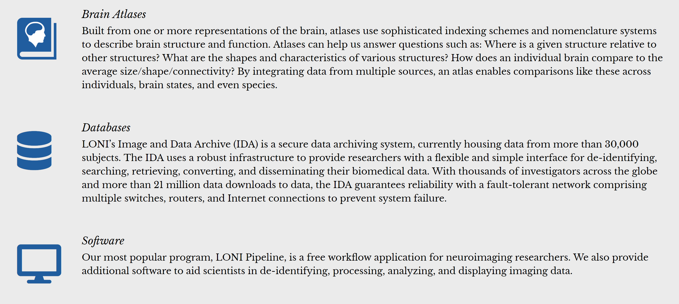

Slide 4
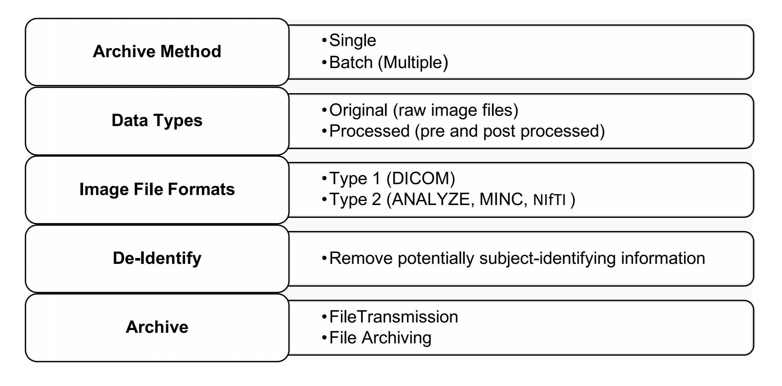
Brain Atlas

Slide 5
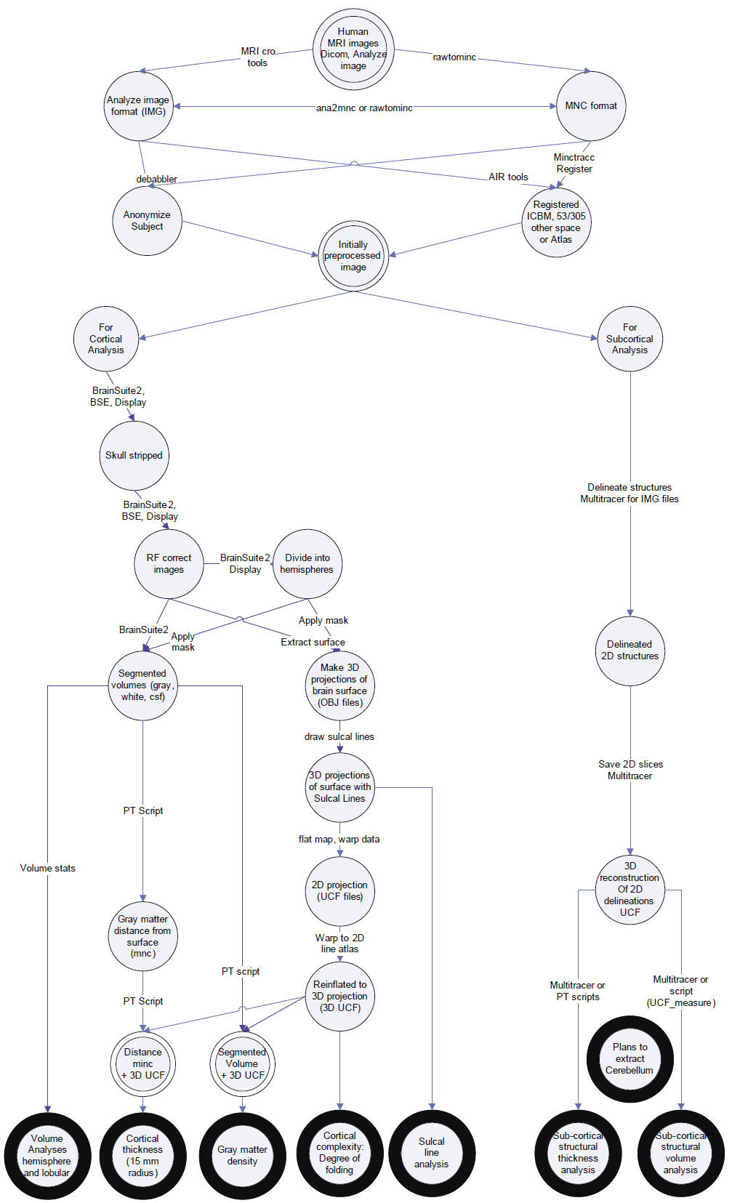

Slide 6
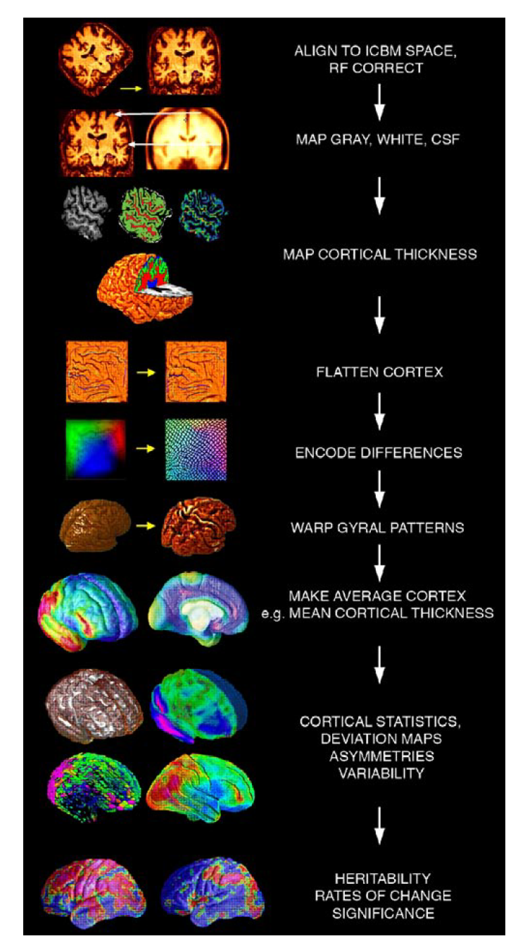
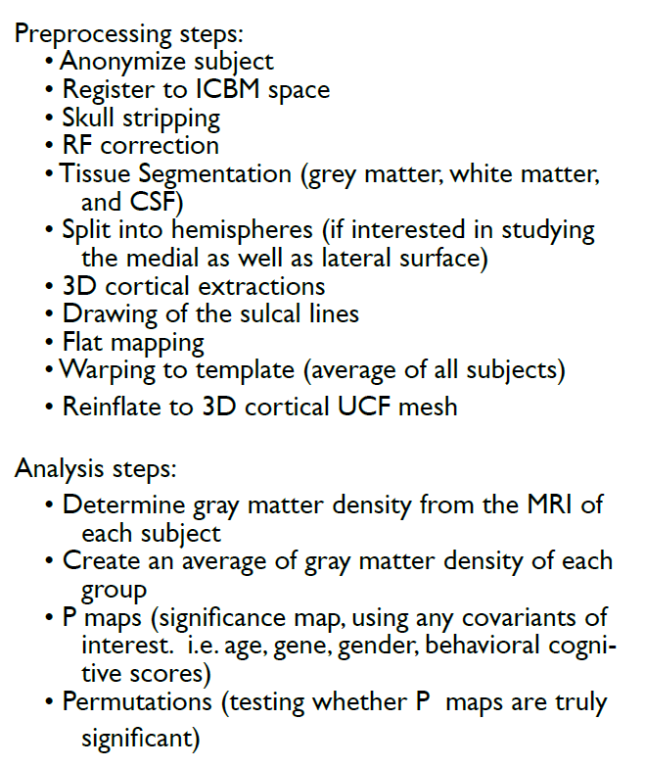

Slide 7
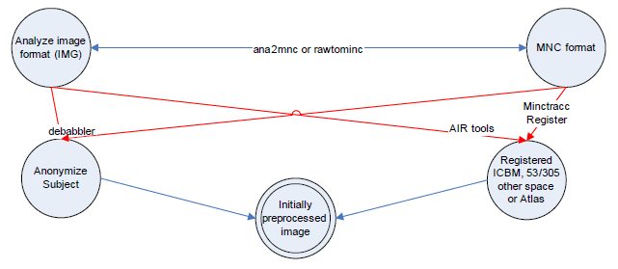
Preprocessing steps for cortical and subcortical analyses

Slide 8
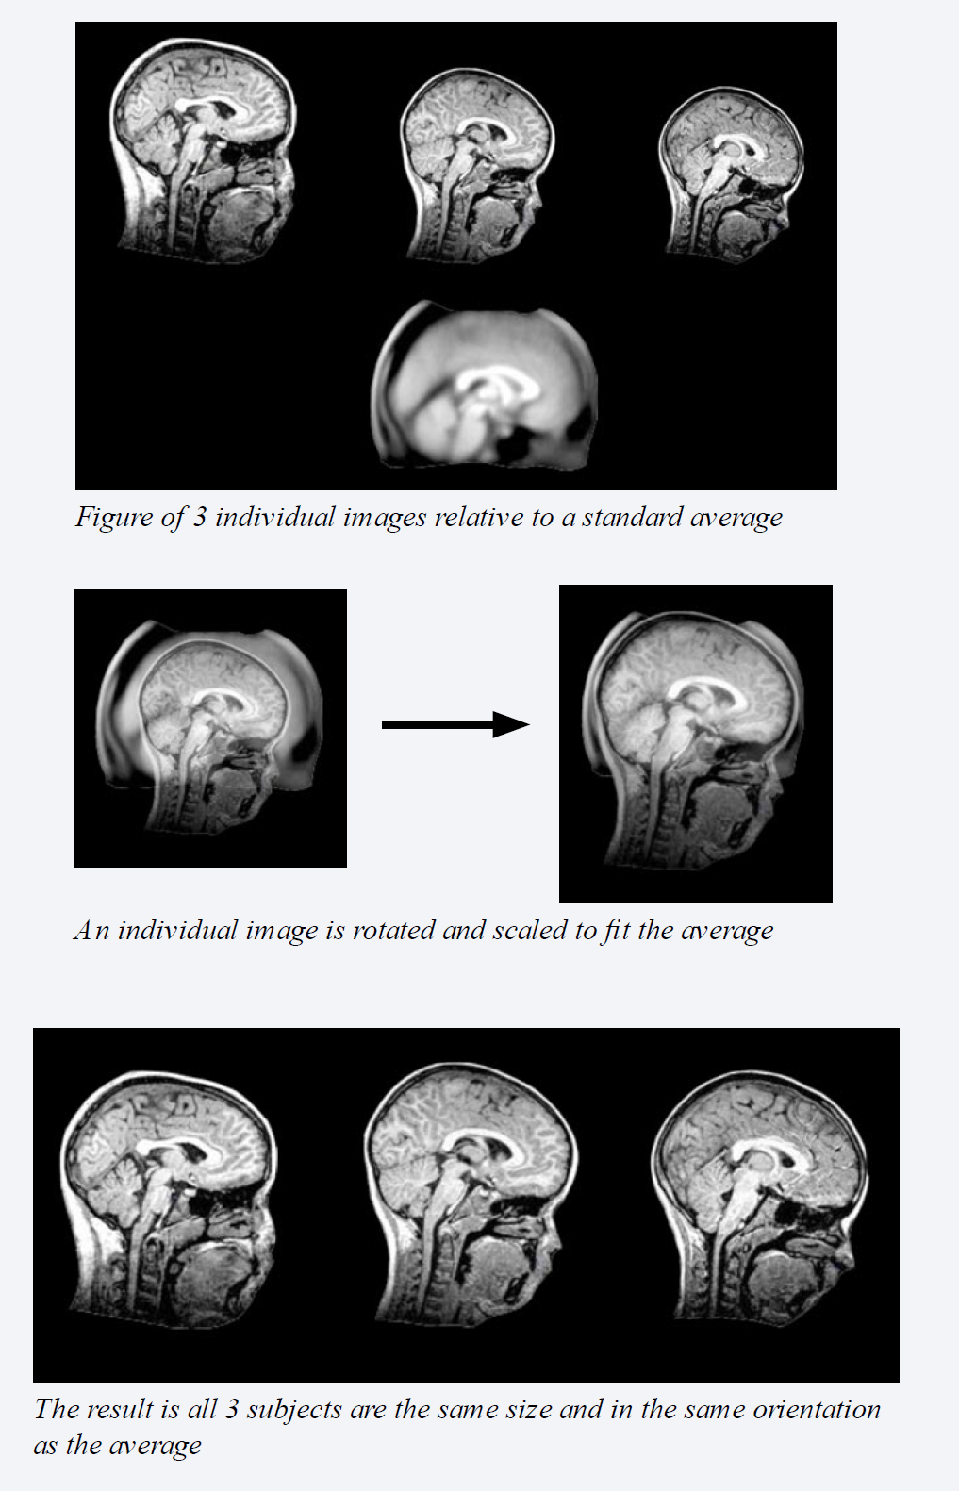
Atlas and Image registration
Spatial and size orientation
Notes on image optimization:
*Pipeline: Skull strip BEFORE image registration
Minctracc: Skull strip AFTER image registration (minctracc estimates the spatial transformation required to register two volumes together)

Slide 9
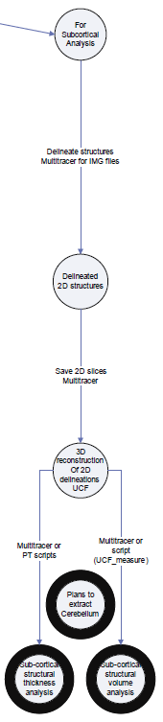
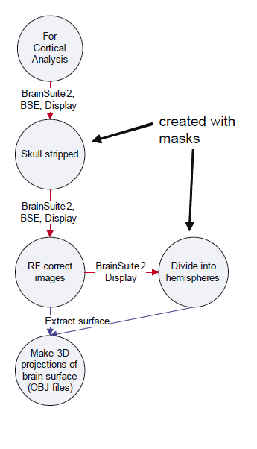
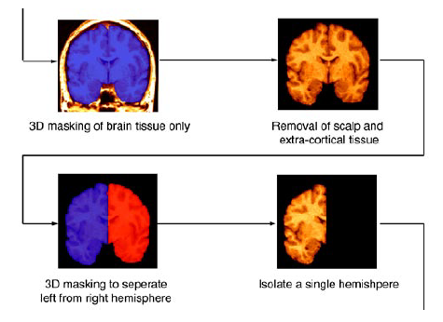
Preprocessing steps for Subcortical and Cortical Processing and Analysis

Slide 10
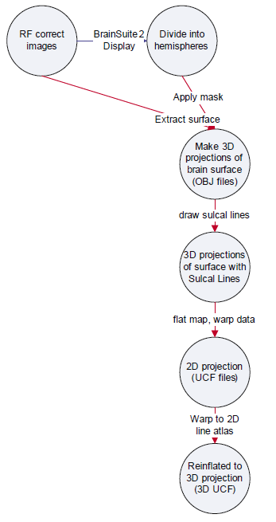
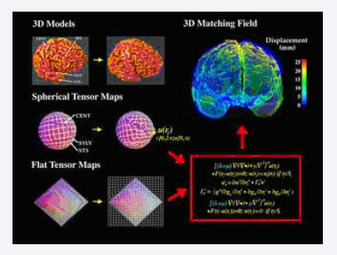
Processing steps for Cortical Surface Extraction and Sulcal Analysis

Slide 11
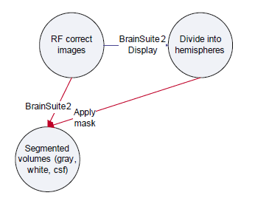
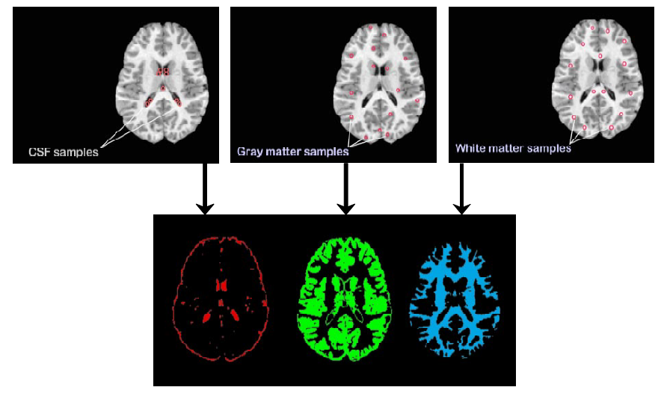
Separation of Gray Matter, White Matter, and CSF

Slide 12
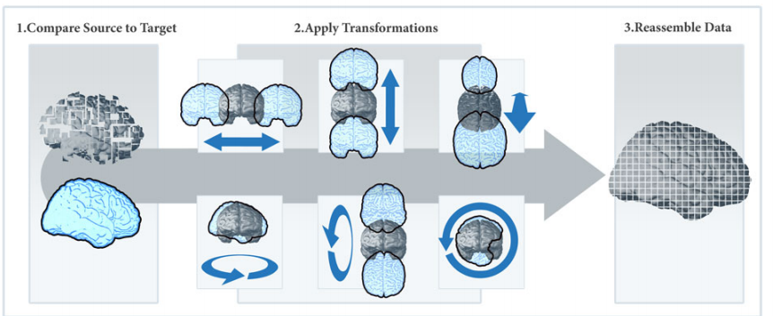
AIR (Automated Image Registration) Registration Workflow
A registration algorithm generates a transformation matrix to align MRI images into standard space.

Slide 13
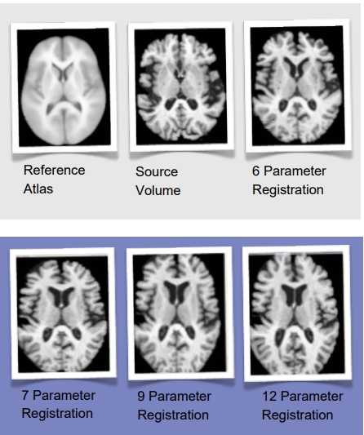
Results
Standard pipeline workflow produce 6 parameter registration.
Tip: Increasing the degree of freedom to fit the source volume to the reference will produce a better image at cost of space and efficiency.

Slide 14
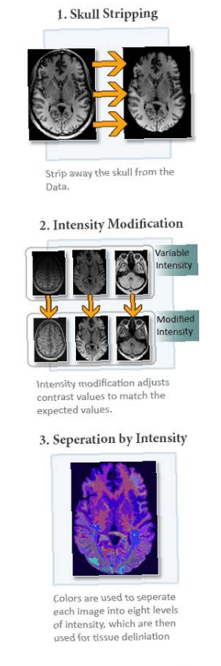
2nd method: BrainSuite (C++)Pre-Processing Image DEMO
BrainSuite is a collection of analysis tools designed to process raw MRI of the human head. Workflow objective is to generate a file containing labels for gray matter, white matter, and cerebrospinal fluid.
Skull strip the brain volume.
Perform Inhomogeneity correction.
Prepping the image for the tissue classifier.

Slide 15
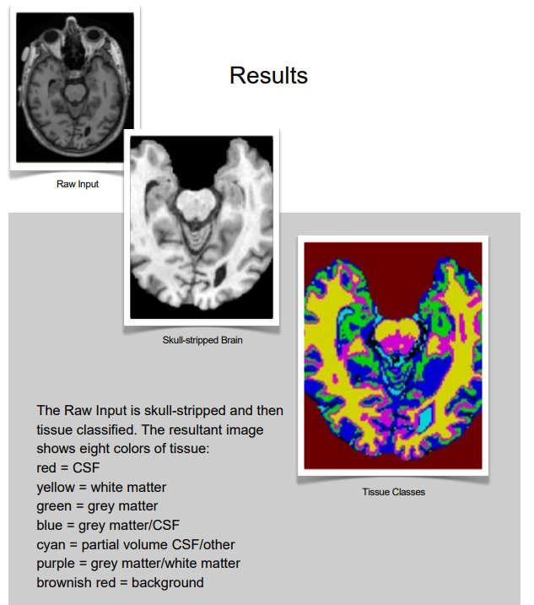

Slide 16
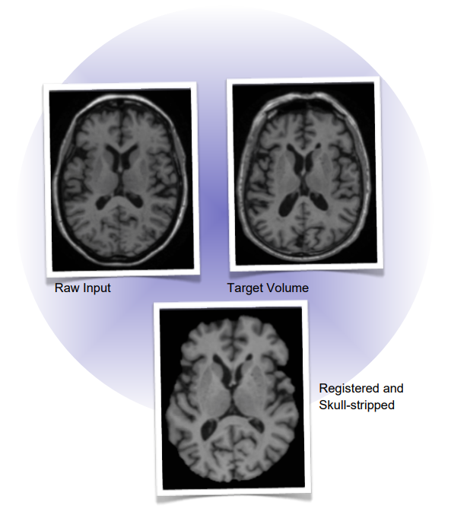
Automated Image Registration (AIR) & BrainSuite
Heterogeneity of image analysis tools using parts of the two previous workflows and aggregate the function into a new workflow.
Results: The raw input is aligned to the target volume and skull-stripped.

Slide 17
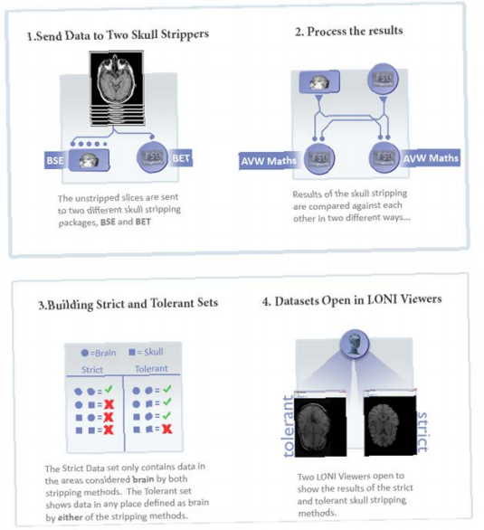
In-depth Skull Stripping
Generate whole-brain masks by running MR data through BSE and BET, then FSL.
Perform skull stripping along two distinct paths

Slide 18
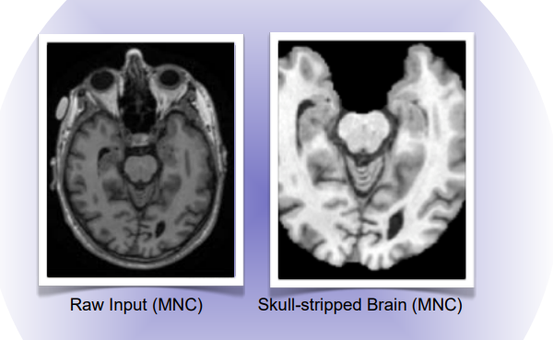
MNC-BrainSuite Heterogenous DEMO
Skull-strip a brain volume in MNC file format.
Utilized Brain Surface Extractor (BSE) skull stripping algorithm.
Use NIFTI input data or analyze file format.
Smart line automatically converts MRI, MINC file to match BSE requirements.

Slide 19
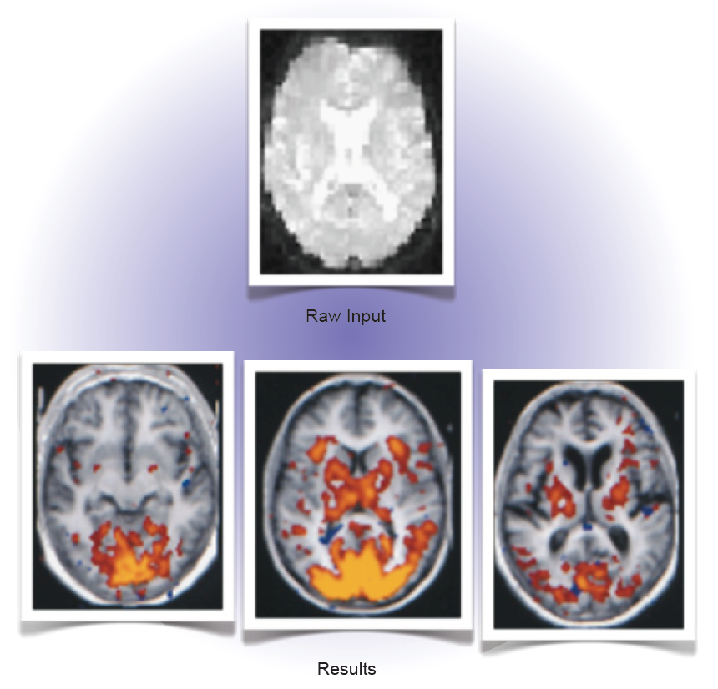
fMRI First Level Analyses
Combine functional volumes
Skull stripping
Registration
Define model
Create activation map

Slide 20
Image Data Archive (IDA)
An environment for archiving, searching, sharing, tracking, and disseminating neuroimaging and related clinical data.

